Slide 1
Seeing Beyond the Spectrum: A Data-Driven Approach to Autism Prediction
FEDRICK SAMUEL W
19MIS1112

Slide 2
INTRODUCTION
Autism spectrum disorder (ASD) is a developmental disability that can cause significant social, communication and behavioral challenges.
There is often nothing about how people with ASD look that sets them apart from other people, but people with ASD may communicate, interact, behave, and learn in ways that are different from most other people.
The learning, thinking, and problem-solving abilities of people with ASD can range from gifted to severely challenged.
Some people with ASD need a lot of help in their daily livesothers need less.
A diagnosis of ASD now includes several conditions that used to be diagnosed separately: autistic disorder, pervasive developmental disorder not otherwise specified (PDD-NOS), and Asperger syndrome. These conditions are now all called autism spectrum disorder."

Slide 3
ABSTRACT
This study focuses on predicting Autism Spectrum Disorder (ASD) using machine learning models based on survey data.
The dataset, comprising features related to communication and behavior, is explored and preprocessed.
A binary classification model is trained and evaluated, utilizing metrics like AUC-ROC score to assess predictive performance.
The analysis aims to contribute to early ASD identification and intervention strategies, emphasizing the significance of data-driven approaches in understanding and addressing developmental disorders.

Slide 4
REVIEW NOTES FOR
Garg, A., Parashar, A., Barman, D., Jain, S., Singhal, D., Masud, M., & Abouhawwash, M. (2022). Autism spectrum disorder prediction by an explainable deep learning approach. Computers, Materials & Continua, 71(1), 1459-1471.
Lyall, K., Rando, J., Toroni, B., Ezeh, T., Constantino, J. N., Croen, L. A., ... & program collaborators for Environmental influences on Child Health Outcomes. (2022). Examining shortened versions of the Social Responsiveness Scale for use in autism spectrum disorder prediction and as a quantitative trait measure: Results from a validation study of 3–5 year old children. JCPP advances, 2(4), e12106.
Albahri, A. S., Hamid, R. A., Zaidan, A. A., & Albahri, O. S. (2023). Early automated prediction model for the diagnosis and detection of children with autism spectrum disorders based on effective sociodemographic and family characteristic features. Neural Computing and Applications, 35(1), 921-947.
Ashmawi, N. S., Hammoda, M. A., & Hammoda, M. (2022). Early prediction and evaluation of risk of autism spectrum disorders. Cureus, 14(3).
Rastegari, M., Salehi, N., & Zare-Mirakabad, F. (2023). Biomarker prediction in autism spectrum disorder using a network-based approach. BMC medical genomics, 16(1), 12.
Alqaysi, M. E., Albahri, A. S., & Hamid, R. A. (2022). Diagnosis-based hybridization of multimedical tests and sociodemographic characteristics of autism spectrum disorder using artificial intelligence and machine learning techniques: a systematic review. International Journal of Telemedicine and Applications, 2022.
Jiang, L., He, R., Li, Y., Yi, C., Peng, Y., Yao, D., ... & Yang, Y. (2022). Predicting the long-term after-effects of rTMS in autism spectrum disorder using temporal variability analysis of scalp EEG. Journal of Neural Engineering, 19(5), 056044.
Surendiran, R., Thangamani, M., Narmatha, C., & Iswarya, M. Effective Autism Spectrum Disorder Prediction to Improve the Clinical Traits using Machine Learning Techniques. International Journal of Engineering Trends and Technology (IJETT),., ISSN, 2231-5381.

Slide 5
9. Zhang, Y., Zhang, S., Chen, B., Jiang, L., Li, Y., Dong, L., ... & Xu, P. (2022). Predicting the symptom severity in autism spectrum disorder based on EEG metrics. IEEE Transactions on Neural Systems and Rehabilitation Engineering, 30, 1898-1907.
10. Wan, Y., Zuo, T., Xu, Z., Zhang, F., Zhan, H., Dorothy, C. H. A. N., ... & Ng, S. C. (2022). Underdevelopment of the gut microbiota and bacteria species as non-invasive markers of prediction in children with autism spectrum disorder. Gut, 71(5), 910-918.
11. Sadeghi, S., Pouretemad, H. R., & Brand, S. (2023). Cognitive control and cognitive flexibility predict severity of depressive symptoms in parents of toddlers with autism spectrum disorder. Current Psychology, 42(29), 25594-25601.
12. Sadeghi, S., Pouretemad, H. R., & Brand, S. (2023). Cognitive control and cognitive flexibility predict severity of depressive symptoms in parents of toddlers with autism spectrum disorder. Current Psychology, 42(29), 25594-25601.
13. Vishal, V., Singh, A., Jinila, Y. B., Shyry, S. P., & Jabez, J. (2022, April). A comparative analysis of prediction of autism spectrum disorder (ASD) using machine learning. In 2022 6th International Conference on Trends in Electronics and Informatics (ICOEI) (pp. 1355-1358). IEEE.
14. Ismail, E., Gad, W., & Hashem, M. (2022). HEC-ASD: a hybrid ensemble-based classification model for predicting autism spectrum disorder disease genes. BMC bioinformatics, 23(1), 554.
15. Zhao, L., Xue, S. W., Sun, Y. K., Lan, Z., Zhang, Z., Xue, Y., ... & Jin, Y. (2022). Altered dynamic functional connectivity of insular subregions could predict symptom severity of male patients with autism spectrum disorder. Journal of Affective Disorders, 299, 504-512.

Slide 6
CHALLENGES
The project encounters multifaceted challenges that significantly influence its trajectory. Ensuring the reliability and completeness of the dataset poses an initial hurdle, necessitating careful handling of missing or inconsistent data to fortify the foundation for accurate model training. Selecting pertinent features for predicting Autism Spectrum Disorder (ASD) proves to be a pivotal challenge, demanding a nuanced understanding of the complex manifestations of ASD.
Balancing the trade-off between model accuracy and interpretability stands out as a continual challenge, especially concerning the need for comprehensibility in predictions for stakeholders such as clinicians and caregivers. Ethical considerations loom large, requiring stringent adherence to privacy standards and responsible data practices given the sensitive nature of health-related information. The challenge of generalizing model predictions across diverse demographic groups, accounting for variations in age, cultural background, and socioeconomic status, underscores the need for robust and inclusive model development. Finally, addressing the risk of overfitting and ensuring the model's validation on new data emerge as critical hurdles, demanding sophisticated validation techniques to guarantee the model's effectiveness beyond the training dataset.
Navigating these challenges requires a holistic and interdisciplinary approach, integrating expertise in machine learning, healthcare, and ethical frameworks. Successfully overcoming these obstacles is paramount to the project's ultimate goal of accurately predicting and comprehending Autism Spectrum Disorder.

Slide 7
OBJECTIVE
This project aims to advance the early detection of Autism Spectrum Disorder (ASD) through the development of a precise and interpretable machine learning model. Focusing on the analysis of survey data, the primary goal is to accurately predict the likelihood of ASD based on key features extracted from participants' responses. Transparency in the model's decision-making process is emphasized to ensure its interpretability by clinicians, caregivers, and other stakeholders, fostering trust and informed decision-making.
Additionally, the project strives for the generalization of the model across diverse populations, taking into account demographic variations. Ethical considerations play a pivotal role, guiding the project's approach to responsible data handling and participant privacy. Beyond predictive accuracy, the project aspires to contribute to the broader understanding of ASD, unveiling patterns within the data that may offer valuable insights into the characteristics of Autism Spectrum Disorder.
Ultimately, the project aims to deliver a practical and impactful tool for early ASD detection, poised for real-world implementation in clinical and community settings.

Slide 8
TOOLS USED TO IMPLEMENTAIONS
JUPYTER NOTEBOOK
PYTHON

Slide 9
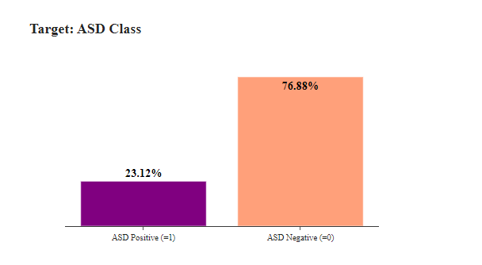
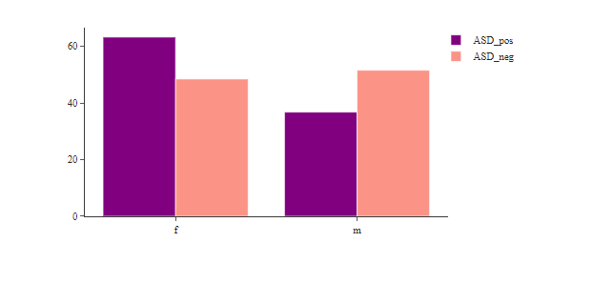
Implementations

Slide 10
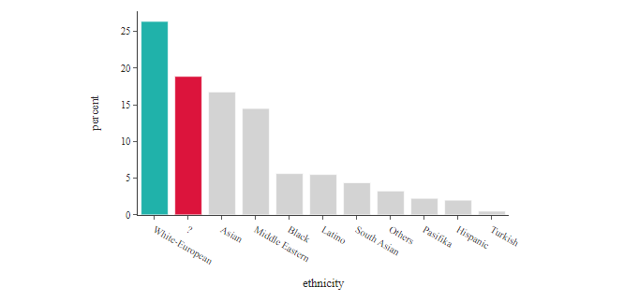
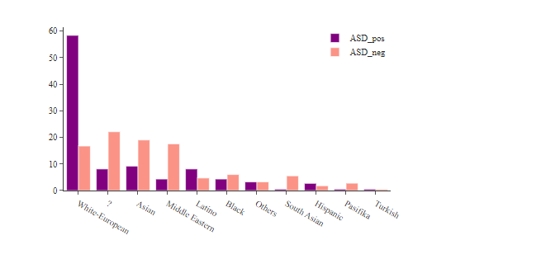
Ethnic group of the patient

Slide 11
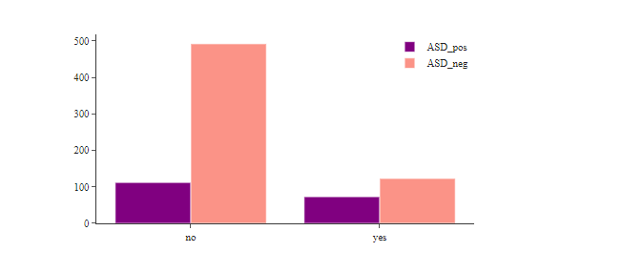
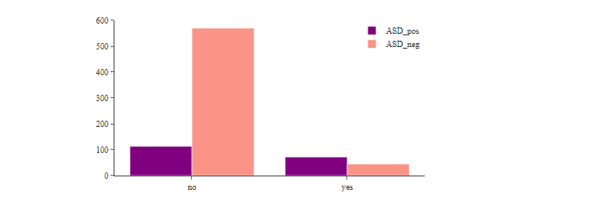
patient had jaundice at the time of birth

Slide 12
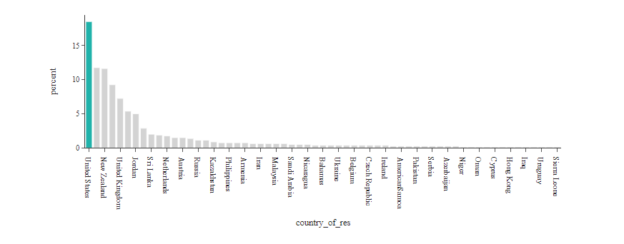
Country of Residence of the patient

Slide 13
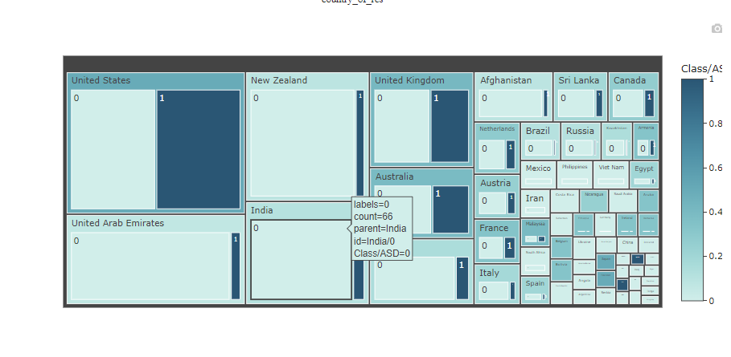

Slide 14
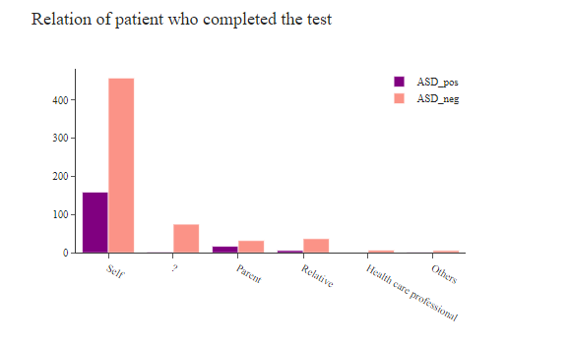
Relation of patient who completed the test

Slide 15
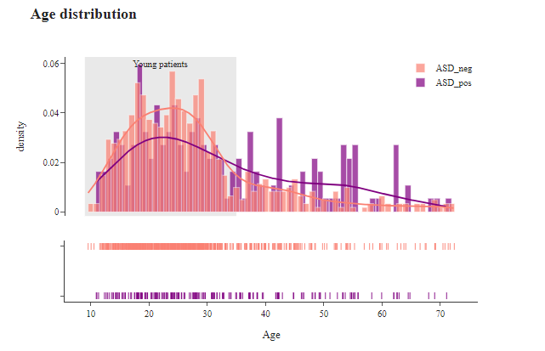
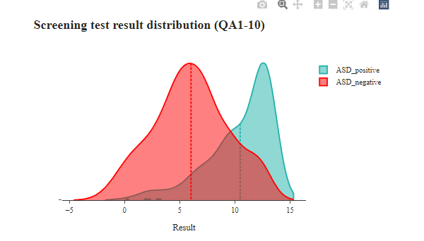
Age Distribution

Slide 16
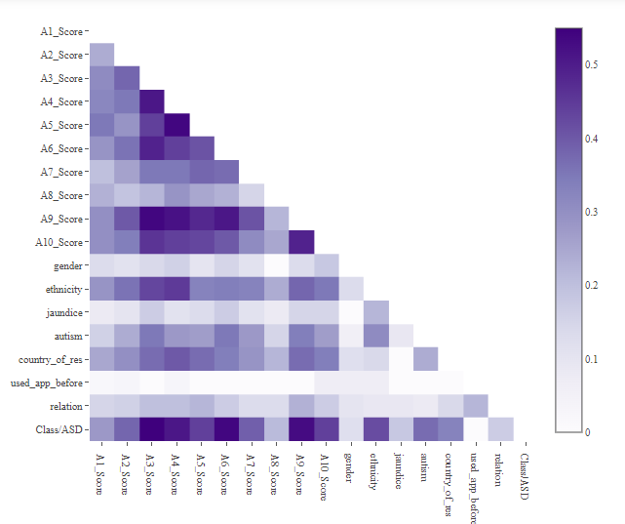
Correlation Heatmap (Categorical features)

Slide 17
REFERENCE:
Garg, A., Parashar, A., Barman, D., Jain, S., Singhal, D., Masud, M., & Abouhawwash, M. (2022). Autism spectrum disorder prediction by an explainable deep learning approach. Computers, Materials & Continua, 71(1), 1459-1471.
Lyall, K., Rando, J., Toroni, B., Ezeh, T., Constantino, J. N., Croen, L. A., ... & program collaborators for Environmental influences on Child Health Outcomes. (2022). Examining shortened versions of the Social Responsiveness Scale for use in autism spectrum disorder prediction and as a quantitative trait measure: Results from a validation study of 3–5 year old children. JCPP advances, 2(4), e12106.
Albahri, A. S., Hamid, R. A., Zaidan, A. A., & Albahri, O. S. (2023). Early automated prediction model for the diagnosis and detection of children with autism spectrum disorders based on effective sociodemographic and family characteristic features. Neural Computing and Applications, 35(1), 921-947.
Ashmawi, N. S., Hammoda, M. A., & Hammoda, M. (2022). Early prediction and evaluation of risk of autism spectrum disorders. Cureus, 14(3).
Rastegari, M., Salehi, N., & Zare-Mirakabad, F. (2023). Biomarker prediction in autism spectrum disorder using a network-based approach. BMC medical genomics, 16(1), 12.
Alqaysi, M. E., Albahri, A. S., & Hamid, R. A. (2022). Diagnosis-based hybridization of multimedical tests and sociodemographic characteristics of autism spectrum disorder using artificial intelligence and machine learning techniques: a systematic review. International Journal of Telemedicine and Applications, 2022.
Jiang, L., He, R., Li, Y., Yi, C., Peng, Y., Yao, D., ... & Yang, Y. (2022). Predicting the long-term after-effects of rTMS in autism spectrum disorder using temporal variability analysis of scalp EEG. Journal of Neural Engineering, 19(5), 056044.
Surendiran, R., Thangamani, M., Narmatha, C., & Iswarya, M. Effective Autism Spectrum Disorder Prediction to Improve the Clinical Traits using Machine Learning Techniques. International Journal of Engineering Trends and Technology (IJETT),., ISSN, 2231-5381.

Slide 18
9. Zhang, Y., Zhang, S., Chen, B., Jiang, L., Li, Y., Dong, L., ... & Xu, P. (2022). Predicting the symptom severity in autism spectrum disorder based on EEG metrics. IEEE Transactions on Neural Systems and Rehabilitation Engineering, 30, 1898-1907.
10. Wan, Y., Zuo, T., Xu, Z., Zhang, F., Zhan, H., Dorothy, C. H. A. N., ... & Ng, S. C. (2022). Underdevelopment of the gut microbiota and bacteria species as non-invasive markers of prediction in children with autism spectrum disorder. Gut, 71(5), 910-918.
11. Sadeghi, S., Pouretemad, H. R., & Brand, S. (2023). Cognitive control and cognitive flexibility predict severity of depressive symptoms in parents of toddlers with autism spectrum disorder. Current Psychology, 42(29), 25594-25601.
12. Sadeghi, S., Pouretemad, H. R., & Brand, S. (2023). Cognitive control and cognitive flexibility predict severity of depressive symptoms in parents of toddlers with autism spectrum disorder. Current Psychology, 42(29), 25594-25601.
13. Vishal, V., Singh, A., Jinila, Y. B., Shyry, S. P., & Jabez, J. (2022, April). A comparative analysis of prediction of autism spectrum disorder (ASD) using machine learning. In 2022 6th International Conference on Trends in Electronics and Informatics (ICOEI) (pp. 1355-1358). IEEE.
14. Ismail, E., Gad, W., & Hashem, M. (2022). HEC-ASD: a hybrid ensemble-based classification model for predicting autism spectrum disorder disease genes. BMC bioinformatics, 23(1), 554.
15. Zhao, L., Xue, S. W., Sun, Y. K., Lan, Z., Zhang, Z., Xue, Y., ... & Jin, Y. (2022). Altered dynamic functional connectivity of insular subregions could predict symptom severity of male patients with autism spectrum disorder. Journal of Affective Disorders, 299, 504-512.

